Slide 1
Protonmail the world's largest secure email service, developed by CERN and MIT scientists. https://protonmail.com/
Waikato Linux User Group
Ian Stewart
22 May 2017.

Slide 2
Protonmail - Overview
Protonmail wiki https://en.wikipedia.org/wiki/ProtonMail
Users > 2 Million
Launched 16 May 2014; 3 years ago
Owner Proton Technologies AG
Created by: Andy Yen, Jason Stockman, Wei Sun
End-to-end encrypted email service founded in 2013 at the CERN research.
Based in the Canton of Geneva, and its servers are located at two locations in Switzerland, outside of US and EU jurisdiction.
Initially invitation-only, ProtonMail opened up to the public in March 2016.
The service can be accessed through a webmail client or dedicated iOS and Android apps.

Slide 3
Protonmail - Overview
March 2016, ProtonMail released version 3.0, which saw the official launch of ProtonMail out of beta.
January 2017, ProtonMail announced support through Tor. https://protonirockerxow.onion
Exclusive use of Linux and other open-source software
Written in Javascript and PHP
Free: 150 messages per day, 500 MB storage.
Paid (4 euros per month): 1,000 messages per day, 5 GB storage, labels and custom filters, encrypted messages to external recipients, own domain, up to 5 email aliases, priority customer support.

Slide 4
Protonmail - Encryption
End-to-end encryption. Through a combination of public-key cryptography and symmetric encryption protocols.
When a user creates a ProtonMail account their browser generates a pair of public and private RSA keys:
The public key is used to encrypt the user's emails and other user data.
The private key capable of decrypting the user's data is symmetrically encrypted with the user's mailbox password.

Slide 5
Protonmail - Encryption
This symmetrical encryption happens in the user's web browser using AES-256. Upon the account registration, the user is asked to provide a login password for their account. ProtonMail also offers users to login with two password mode that require a login password and a mailbox password.
The login password is used for authentication.
The mailbox password encrypts the user's mailbox that contains received emails, contacts and user information as well as a private encryption key.

Slide 6
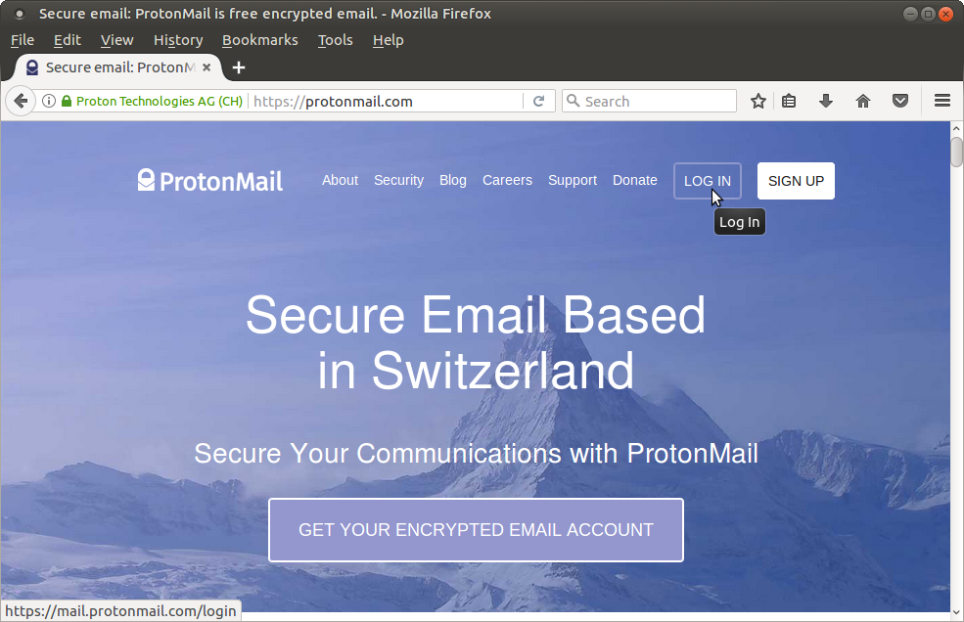
Protonmail - main page
Firefox browser. https://protonmail.com

Slide 7
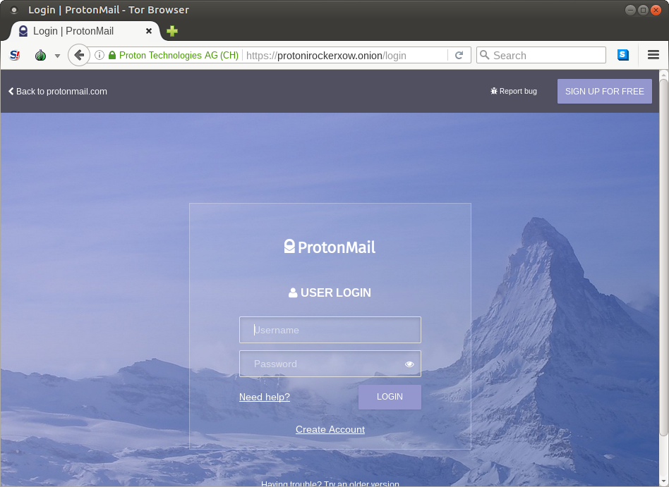
Protonmail – login page
TOR browser. https://protonirockerxow.onion/login

Slide 8
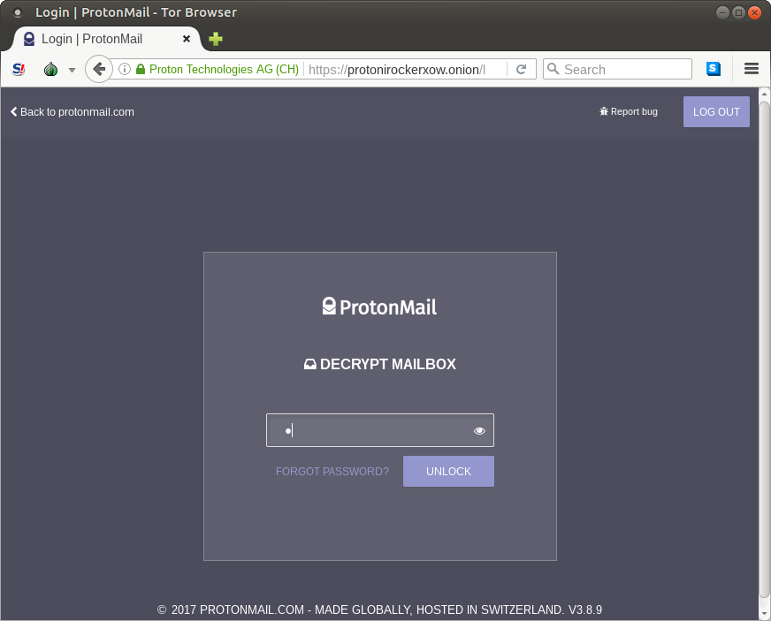
Protonmail – login
TOR browser. https://protonirockerxow.onion/login

Slide 9
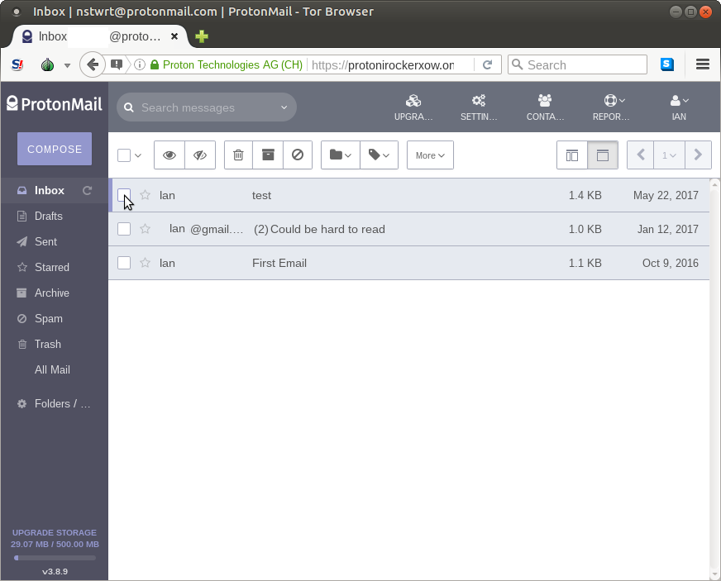
Protonmail – Inbox
Inbox

Slide 10
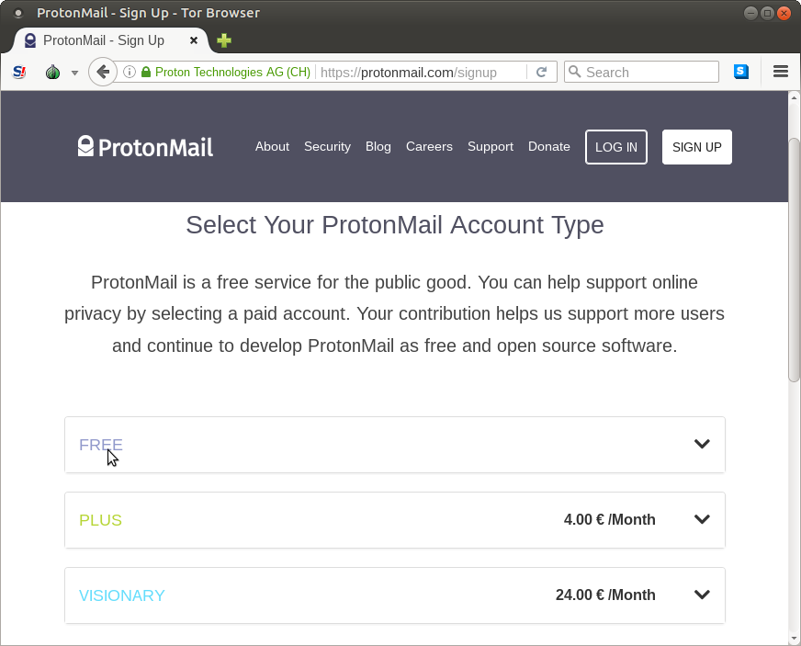
Protonmail – Sign Up
Signup for Free account.

Slide 11
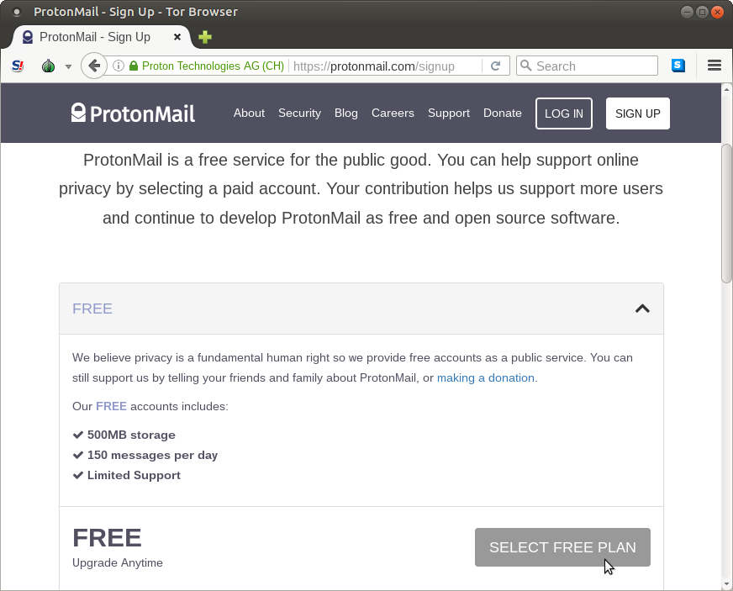
Protonmail – Sign Up
Signup for Free account.

Slide 12
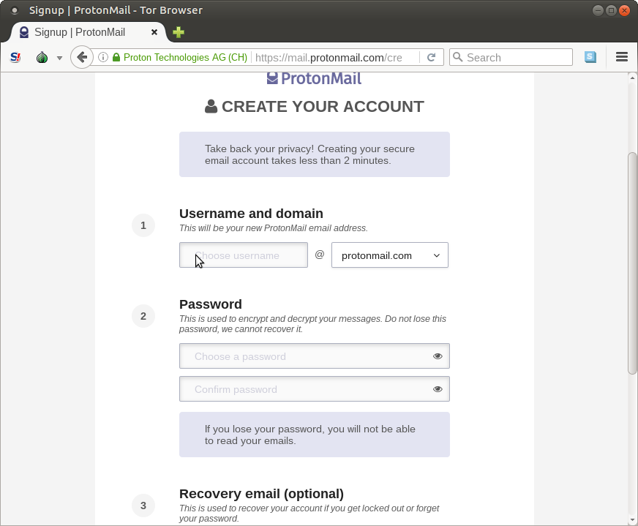
Protonmail – Sign Up
Signup for Free account.

Slide 13
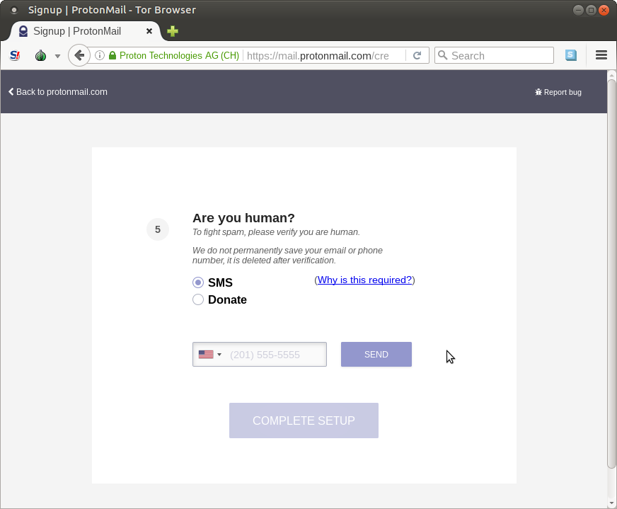
Protonmail – Sign Up
Signup for Free account.

Slide 14
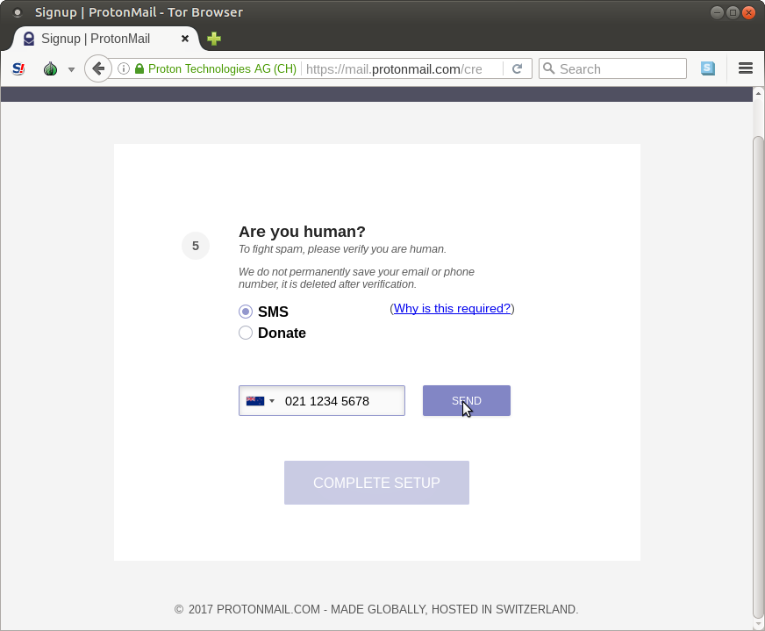
Protonmail – Sign Up
Signup for Free account.

Slide 15
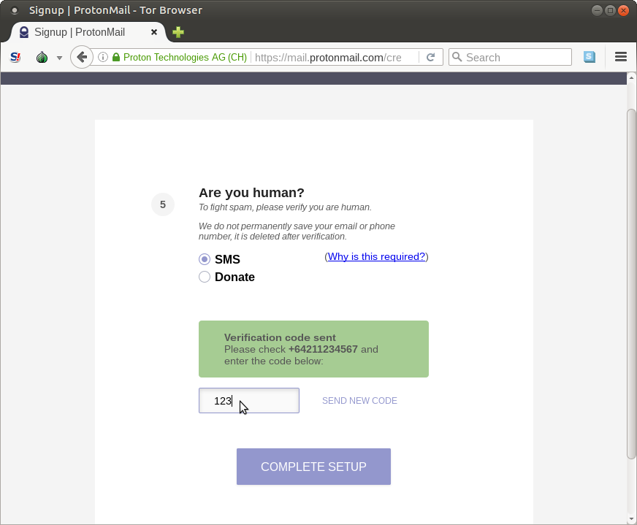
Protonmail – Sign Up
Signup for Free account.

Slide 16
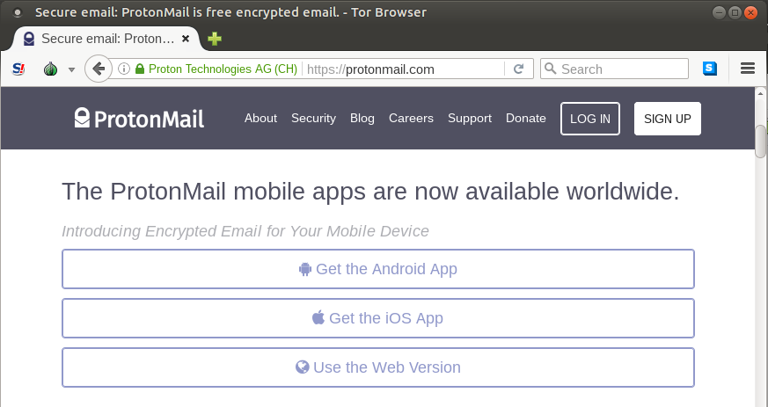
Protonmail – Apps
Mobile Apps.

Slide 17
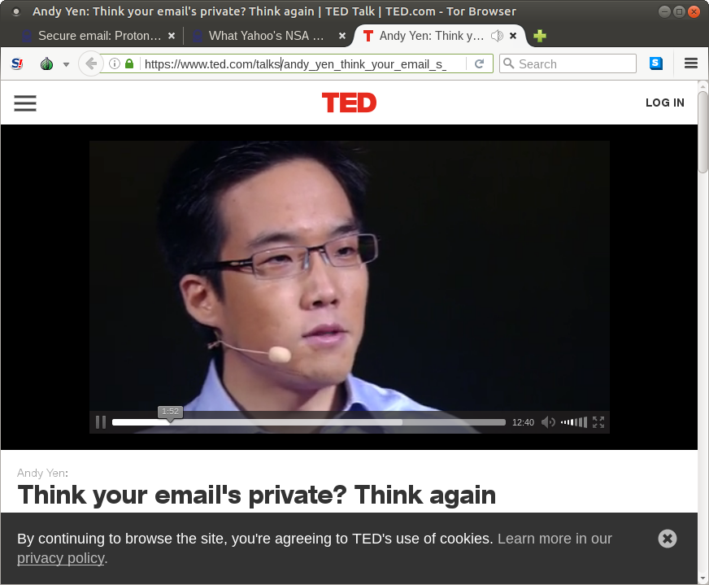
Protonmail – TED talk
TED talk by Andy Yen
https://www.ted.com/talks/andy_yen_think_your_email_s_private_think_again

Slide 18
End

